Slide 1

Operating Systems Unit II::Process Management Processes

Slide 2
Outline
Process Concept
Process Scheduling
Operations on Processes
Cooperating Processes
Interprocess Communication
Communication in Client-Server Systems

Slide 3
1.Process Concept
An operating system executes a variety of programs:
Batch system – jobs
Time-shared systems – user programs or tasks
Textbook uses the terms job and process almost interchangeably.
Process – a program in execution; process execution must progress in sequential fashion.
A process includes:
program counter
stack
data section

Slide 4
Process State
As a process executes, it changes state
new: The process is being created.
running: Instructions are being executed.
waiting: The process is waiting for some event to occur.
ready: The process is waiting to be assigned to a process.
terminated: The process has finished execution.

Slide 5
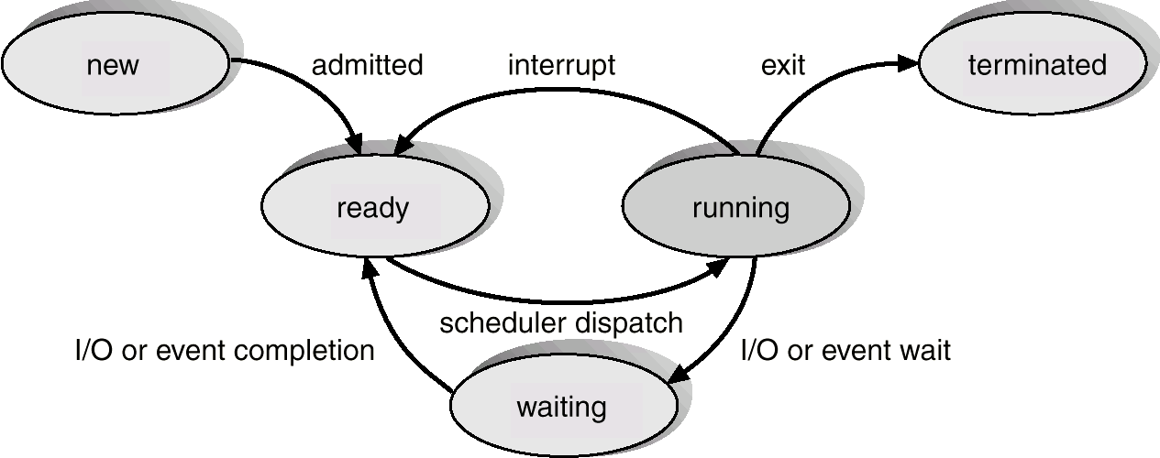
Diagram of Process State

Slide 6
Process Control Block (PCB)
Information associated with each process.
Process state
Program counter
CPU registers
CPU scheduling information
Memory-management information
Accounting information
I/O status information

Slide 7
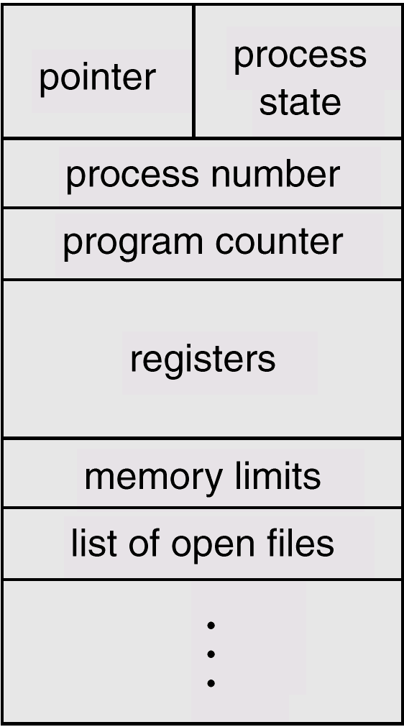
Process Control Block (PCB)

Slide 8
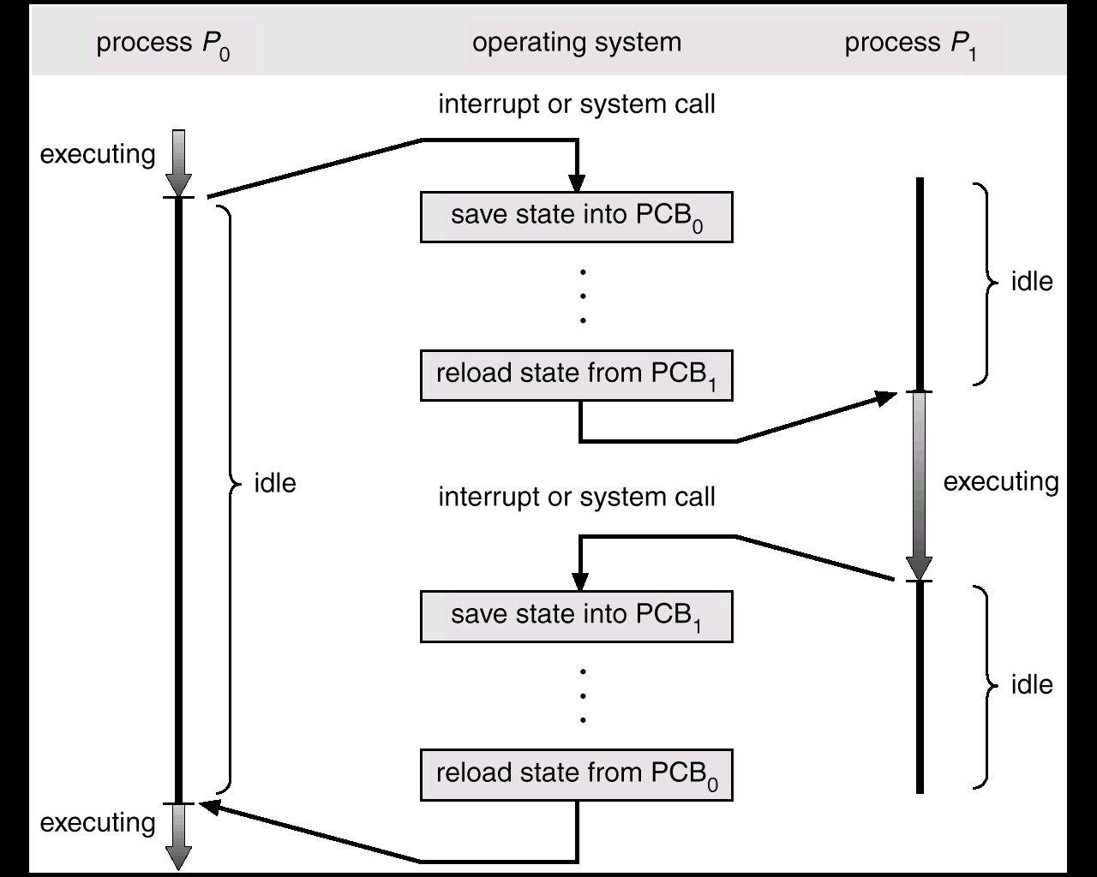
CPU Switch From Process to Process

Slide 9
Process Scheduling Queues
Job queue – set of all processes in the system.
Ready queue – set of all processes residing in main memory, ready and waiting to execute.
Device queues – set of processes waiting for an I/O device.
Process migration between the various queues.

Slide 10
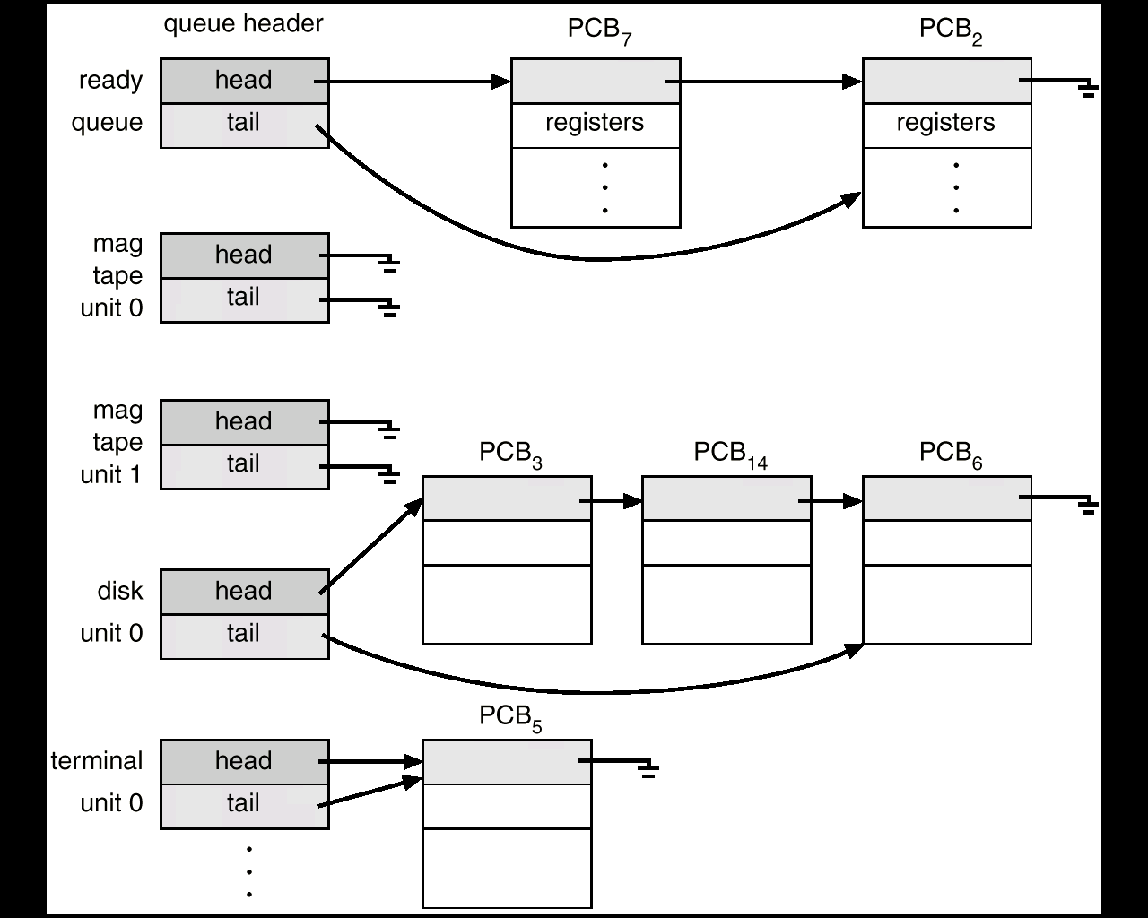
Ready Queue And Various I/O Device Queues

Slide 11
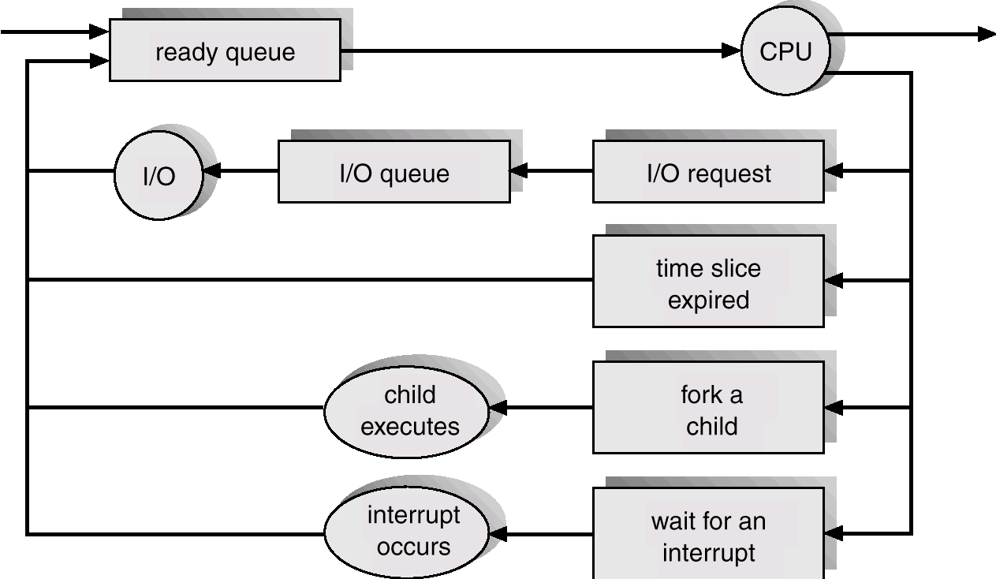
2.Representation of Process Scheduling

Slide 12
Schedulers
Long-term scheduler (or job scheduler) – selects which processes should be brought into the ready queue.
Short-term scheduler (or CPU scheduler) – selects which process should be executed next and allocates CPU.

Slide 13
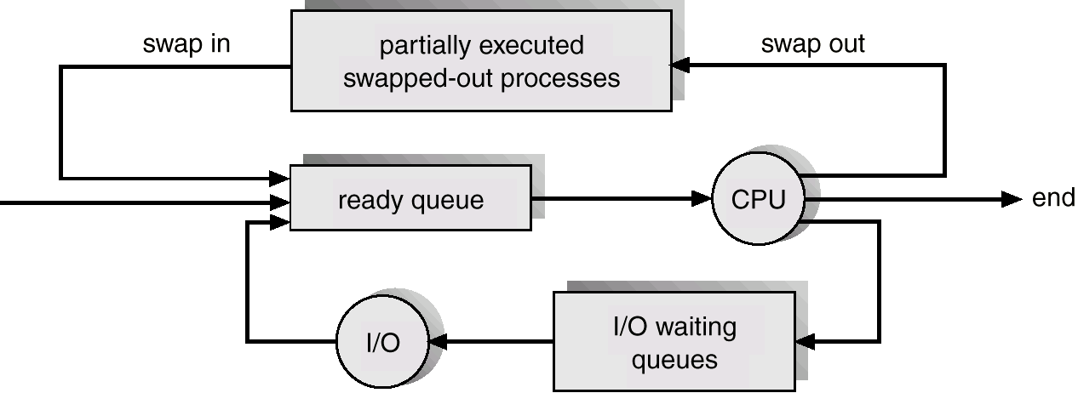
Addition of Medium Term Scheduling

Slide 14
Schedulers (Cont.)
Short-term scheduler is invoked very frequently (milliseconds) ⇒ (must be fast).
Long-term scheduler is invoked very infrequently (seconds, minutes) ⇒ (may be slow).
The long-term scheduler controls the degree of multiprogramming.
Processes can be described as either:
I/O-bound process – spends more time doing I/O than computations, many short CPU bursts.
CPU-bound process – spends more time doing computations; few very long CPU bursts.

Slide 15
Context Switch
When CPU switches to another process, the system must save the state of the old process and load the saved state for the new process.
Context-switch time is overhead; the system does no useful work while switching.
Time dependent on hardware support.

Slide 16
3.Process Creation
Parent process create children processes, which, in turn create other processes, forming a tree of processes.
Resource sharing
Parent and children share all resources.
Children share subset of parent’s resources.
Parent and child share no resources.
Execution
Parent and children execute concurrently.
Parent waits until children terminate.

Slide 17
Process Creation (Cont.)
Address space
Child duplicate of parent.
Child has a program loaded into it.
UNIX examples
fork system call creates new process
exec system call used after a fork to replace the process’ memory space with a new program.

Slide 18
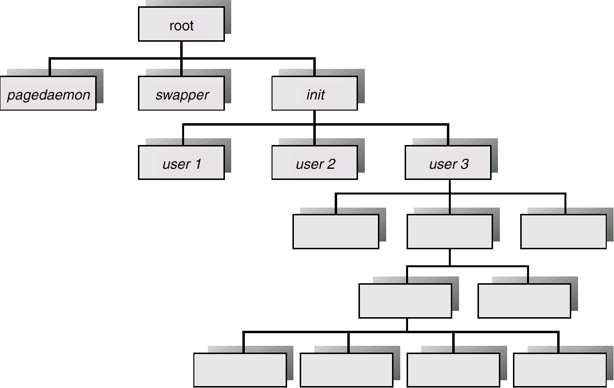
Processes Tree on a UNIX System

Slide 19
Process Termination
Process executes last statement and asks the operating system to decide it (exit).
Output data from child to parent (via wait).
Process’ resources are deallocated by operating system.
Parent may terminate execution of children processes (abort).
Child has exceeded allocated resources.
Task assigned to child is no longer required.
Parent is exiting.
Operating system does not allow child to continue if its parent terminates.
Cascading termination.

Slide 20
4.Cooperating Processes
Independent process cannot affect or be affected by the execution of another process.
Cooperating process can affect or be affected by the execution of another process
Advantages of process cooperation
Information sharing
Computation speed-up
Modularity
Convenience

Slide 21
Producer-Consumer Problem
Paradigm for cooperating processes, producer process produces information that is consumed by a consumer process.
unbounded-buffer places no practical limit on the size of the buffer.
bounded-buffer assumes that there is a fixed buffer size.

Slide 22
Bounded-Buffer – Shared-Memory Solution
Shared data
#define BUFFER_SIZE 10
Typedef struct {
. . .
} item;
item buffer[BUFFER_SIZE];
int in = 0;
int out = 0;
Solution is correct, but can only use BUFFER_SIZE-1 elements

Slide 23
Bounded-Buffer – Producer Process
item nextProduced;
while (1) {
while (((in + 1) % BUFFER_SIZE) == out)
; /* do nothing */
buffer[in] = nextProduced;
in = (in + 1) % BUFFER_SIZE;
}

Slide 24
Bounded-Buffer – Consumer Process
item nextConsumed;
while (1) {
while (in == out)
; /* do nothing */
nextConsumed = buffer[out];
out = (out + 1) % BUFFER_SIZE;
}

Slide 25
5.Interprocess Communication (IPC)
Mechanism for processes to communicate and to synchronize their actions.
Message system – processes communicate with each other without resorting to shared variables.
IPC facility provides two operations:
send(message) – message size fixed or variable
receive(message)
If P and Q wish to communicate, they need to:
establish a communication link between them
exchange messages via send/receive
Implementation of communication link
physical (e.g., shared memory, hardware bus)
logical (e.g., logical properties)

Slide 26
Implementation Questions
How are links established?
Can a link be associated with more than two processes?
How many links can there be between every pair of communicating processes?
What is the capacity of a link?
Is the size of a message that the link can accommodate fixed or variable?
Is a link unidirectional or bi-directional?

Slide 27
6.Direct Communication
Processes must name each other explicitly:
send (P, message) – send a message to process P
receive(Q, message) – receive a message from process Q
Properties of communication link
Links are established automatically.
A link is associated with exactly one pair of communicating processes.
Between each pair there exists exactly one link.
The link may be unidirectional, but is usually bi-directional.

Slide 28
Indirect Communication
Messages are directed and received from mailboxes (also referred to as ports).
Each mailbox has a unique id.
Processes can communicate only if they share a mailbox.
Properties of communication link
Link established only if processes share a common mailbox
A link may be associated with many processes.
Each pair of processes may share several communication links.
Link may be unidirectional or bi-directional.

Slide 29
Indirect Communication
Operations
create a new mailbox
send and receive messages through mailbox
destroy a mailbox
Primitives are defined as:
send(A, message) – send a message to mailbox A
receive(A, message) – receive a message from mailbox A

Slide 30
Indirect Communication
Mailbox sharing
P₁, P₂, and P₃ share mailbox A.
P₁, sends; P₂ and P₃ receive.
Who gets the message?
Solutions
Allow a link to be associated with at most two processes.
Allow only one process at a time to execute a receive operation.
Allow the system to select arbitrarily the receiver. Sender is notified who the receiver was.

Slide 31
Synchronization
Message passing may be either blocking or non-blocking.
Blocking is considered synchronous
Non-blocking is considered asynchronous
send and receive primitives may be either blocking or non-blocking.

Slide 32
Buffering
Queue of messages attached to the link; implemented in one of three ways.
1. Zero capacity – 0 messages Sender must wait for receiver (rendezvous).
2. Bounded capacity – finite length of n messages Sender must wait if link full.
3. Unbounded capacity – infinite length Sender never waits.

Slide 33
Client-Server Communication
Sockets
Remote Procedure Calls
Remote Method Invocation (Java)

Slide 34
Sockets
A socket is defined as an endpoint for communication.
Concatenation of IP address and port
The socket 161.25.19.8:1625 refers to port 1625 on host 161.25.19.8
Communication consists between a pair of sockets.

Slide 35
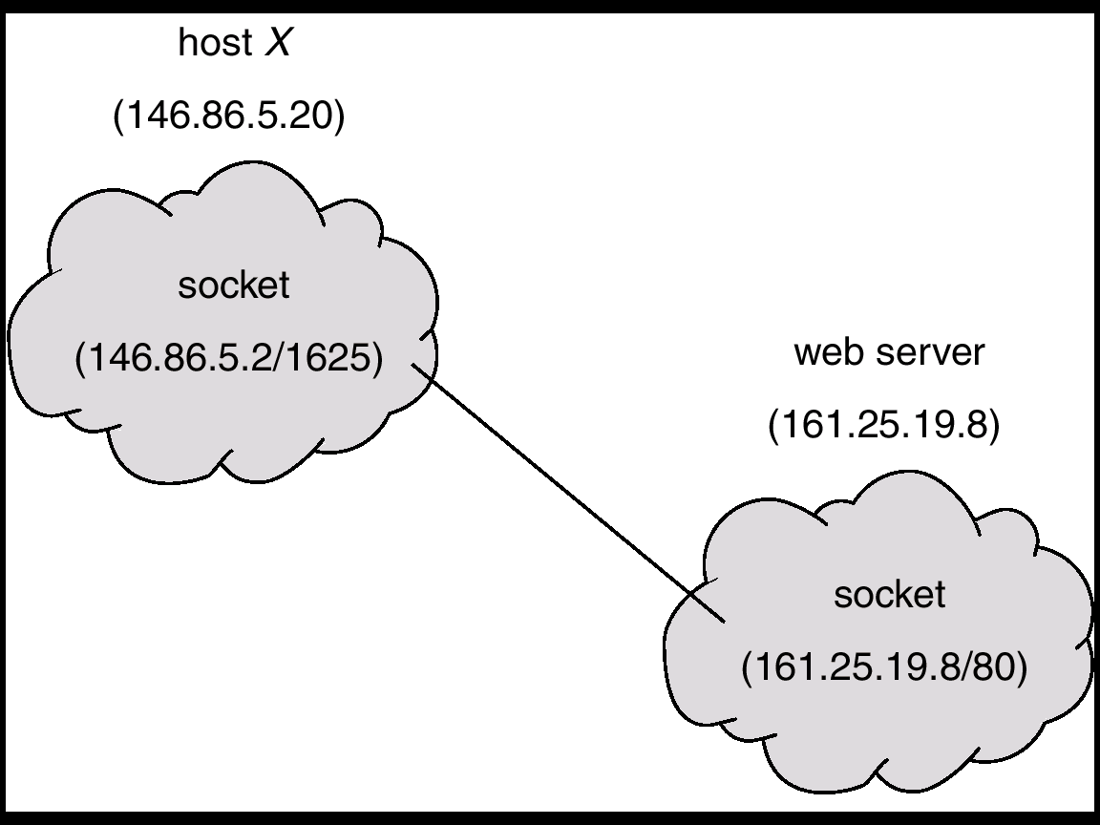
Socket Communication

Slide 36
Remote Procedure Calls
Remote procedure call (RPC) abstracts procedure calls between processes on networked systems.
Stubs – client-side proxy for the actual procedure on the server.
The client-side stub locates the server and marshalls the parameters.
The server-side stub receives this message, unpacks the marshalled parameters, and peforms the procedure on the server.

Slide 37
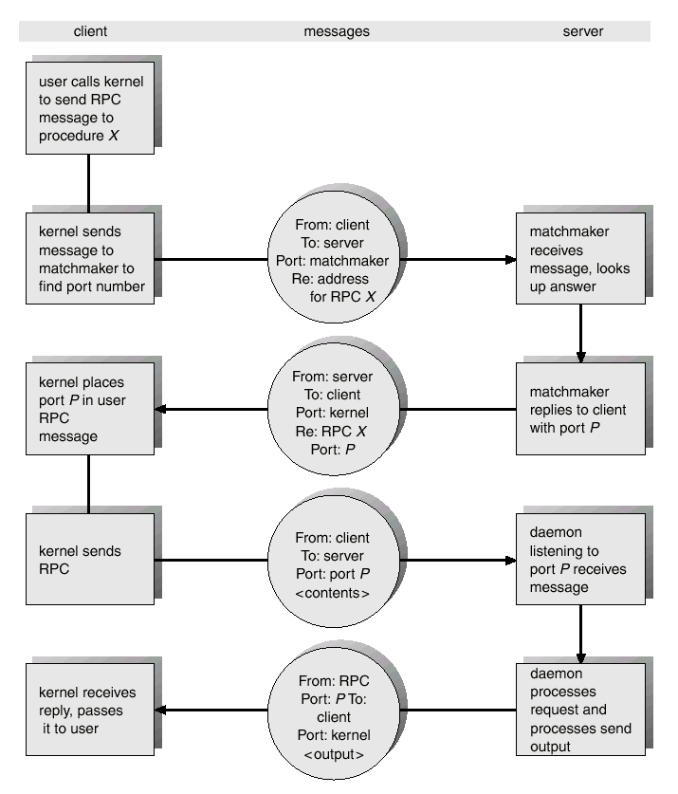
Execution of RPC

Slide 38
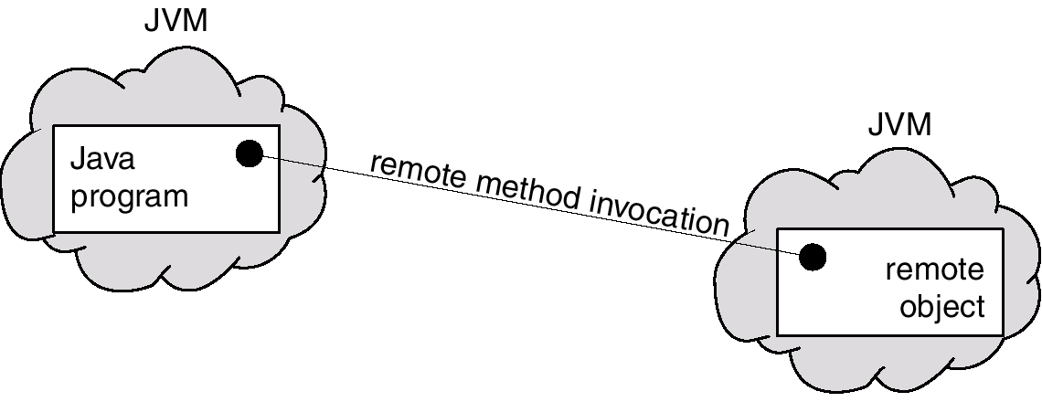
Remote Method Invocation
Remote Method Invocation (RMI) is a Java mechanism similar to RPCs.
RMI allows a Java program on one machine to invoke a method on a remote object.

Slide 39
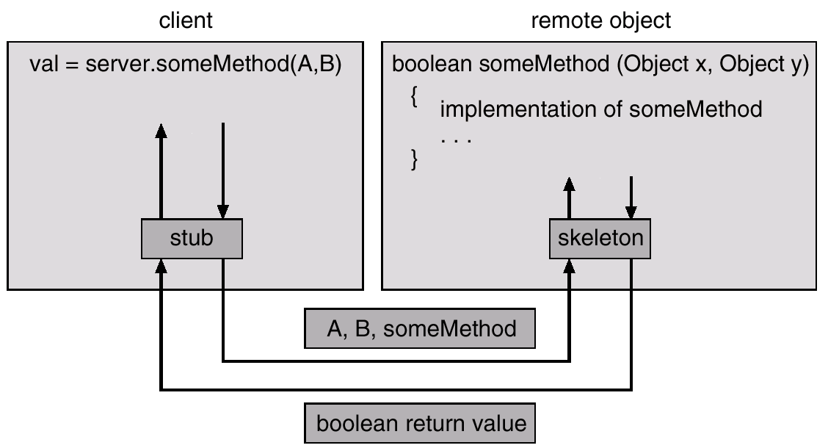
Marshalling Parameters

Slide 40
Unit II - Operating Systems Multithreading Model

Slide 41
Outline
Overview
Multithreading Models
Threading Issues
Pthreads
Solaris 2 Threads
Windows 2000 Threads
Linux Threads
Java Threads

Slide 42
Thread
What is Thread in OS?
Thread is an execution unit that is part of a process.
A process can have multiple threads, all executing at the same time.
A thread is lightweight process because they have their own stack and share the same address space with process.

Slide 43
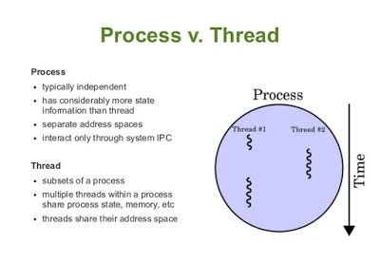

Slide 44
Multithread
What is Multithreading?
Multithreading refers to multiple threads of execution within an operating system.
In simple terms, two or more threads of a same process are executing simultaneously.

Slide 45
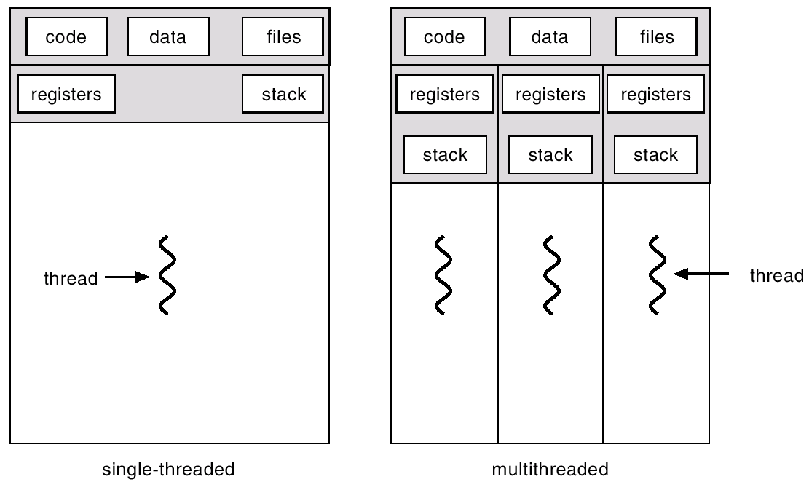
Single Vs Multithreaded Processes

Slide 46
Benefits
Responsiveness
Resource Sharing
Economy
Utilization of MP Architectures

Slide 47
User Threads
Thread management done by user-level threads library.
Examples
- POSIX Pthreads
- Mach C-threads
- Solaris 2 UI threads

Slide 48
Kernel Threads
Kernal Threads directly supported by the OS.
Examples
- Windows NT/2000
- Solaris 2
- Tru64 UNIX
- BeOS
- Linux

Slide 49
Multithreading Models
Many-to-One
One-to-One
Many-to-Many

Slide 50
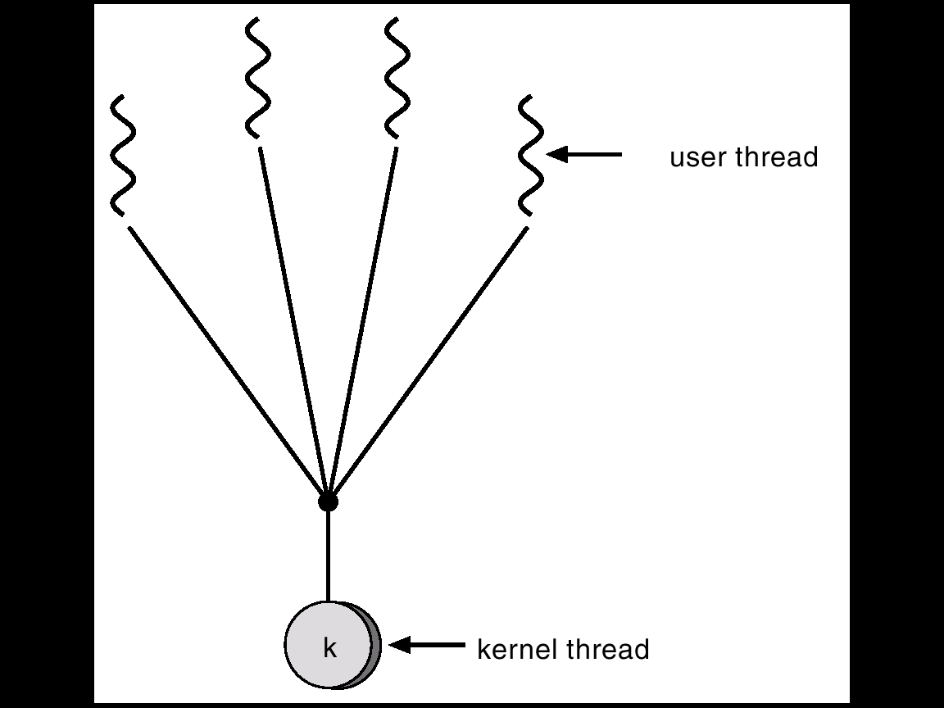
Many-to-One
Many user-level threads mapped to single kernel thread.
Used on systems that do not support kernel threads.
For Example : Green thread in Solaris 2

Slide 51
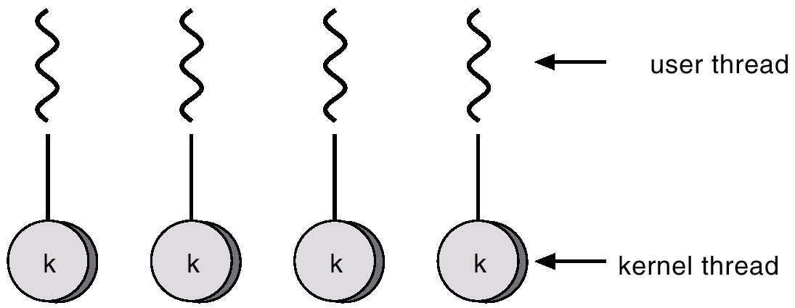
One-to-One
Each user-level thread maps to kernel thread.
Examples
- Windows NT/2000
- OS/2

Slide 52
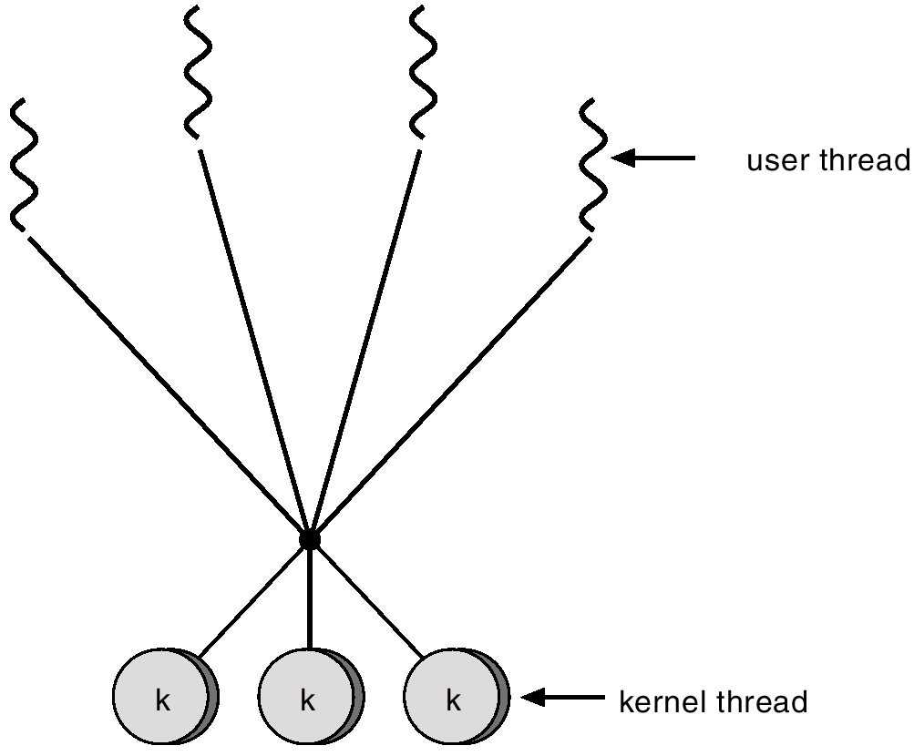
Many-to-Many Model
Allows many user level threads to be mapped to many kernel threads.
Allows the operating system to create a sufficient number of kernel threads.
Example :Solaris 2, IRIX, HP-UX and True 64 Unix

Slide 53
Threading Issues
Semantics of fork() and exec() system calls.
Thread cancellation.
Signal handling
Thread pools
Thread specific data

Slide 54
Pthreads
A POSIX standard (IEEE 1003.1c) defining API for thread creation and synchronization.
API specifies behavior of the thread library, implementation is up to development of the library.
It is Common in UNIX operating systems.
The Windows OS generally not supported.

Slide 55
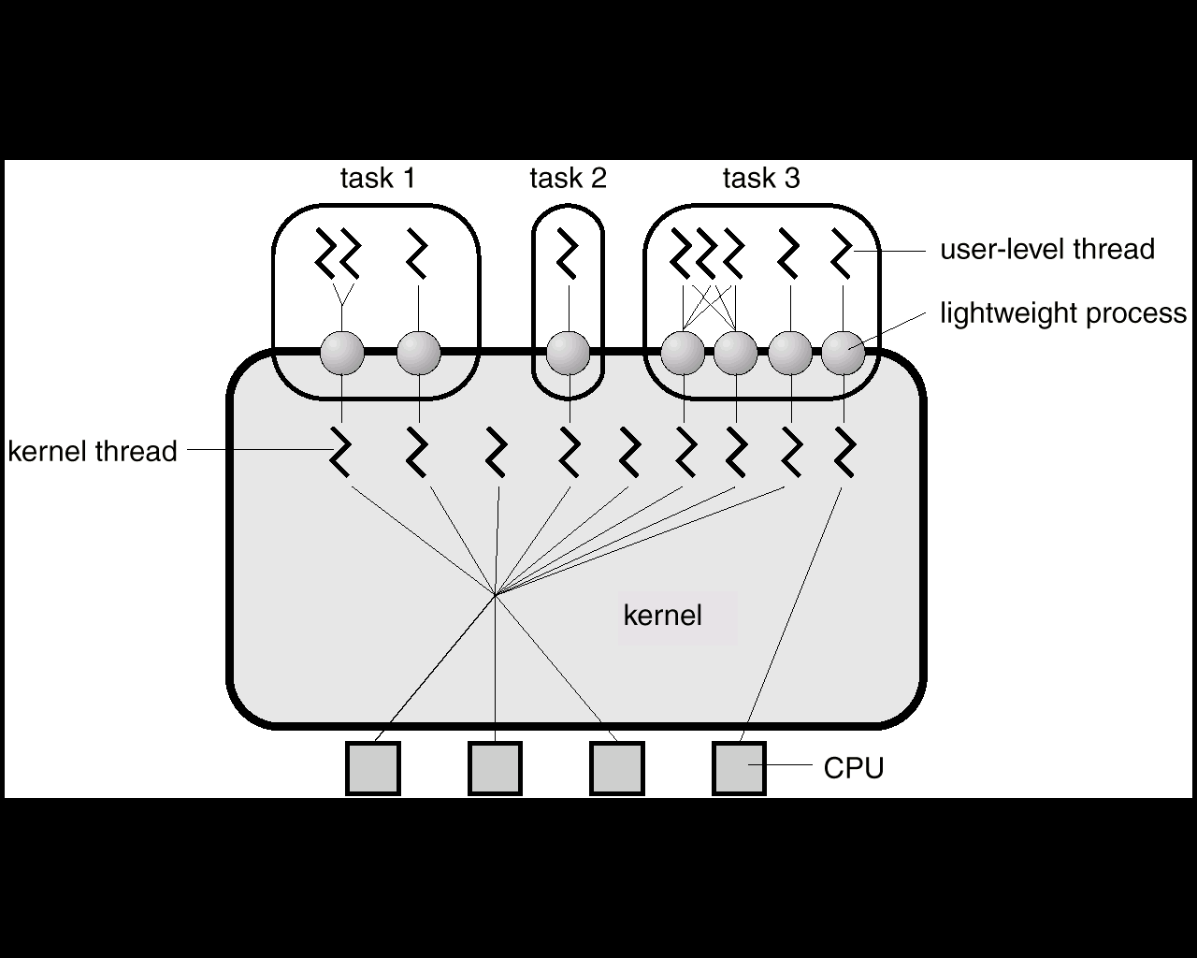
Solaris 2 Threads

Slide 56
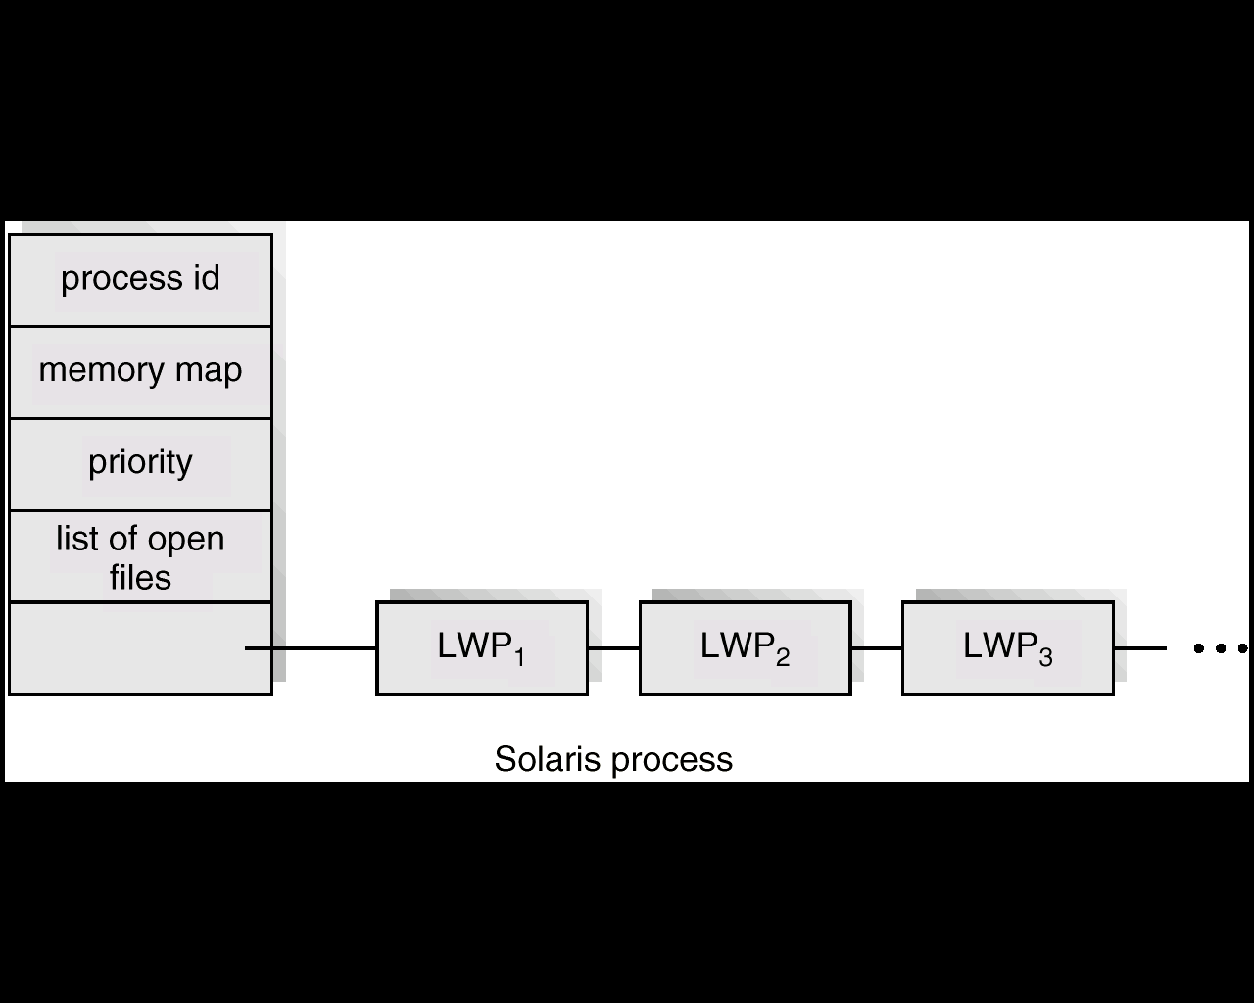
Solaris Process

Slide 57
Windows 2000 Threads
Implements the one-to-one mapping.
Each thread contains
- a thread id
- register set
- separate user and kernel stacks
- private data storage area

Slide 58
Linux Threads
Linux refers to them as tasks rather than threads.
Thread creation is done through clone() system call.
Clone() allows a child task to share the address space of the parent task (process)

Slide 59
Java Threads
Java threads may be created by:
Extending Thread class
Implementing the Runnable interface
Java threads are managed by the JVM.

Slide 60
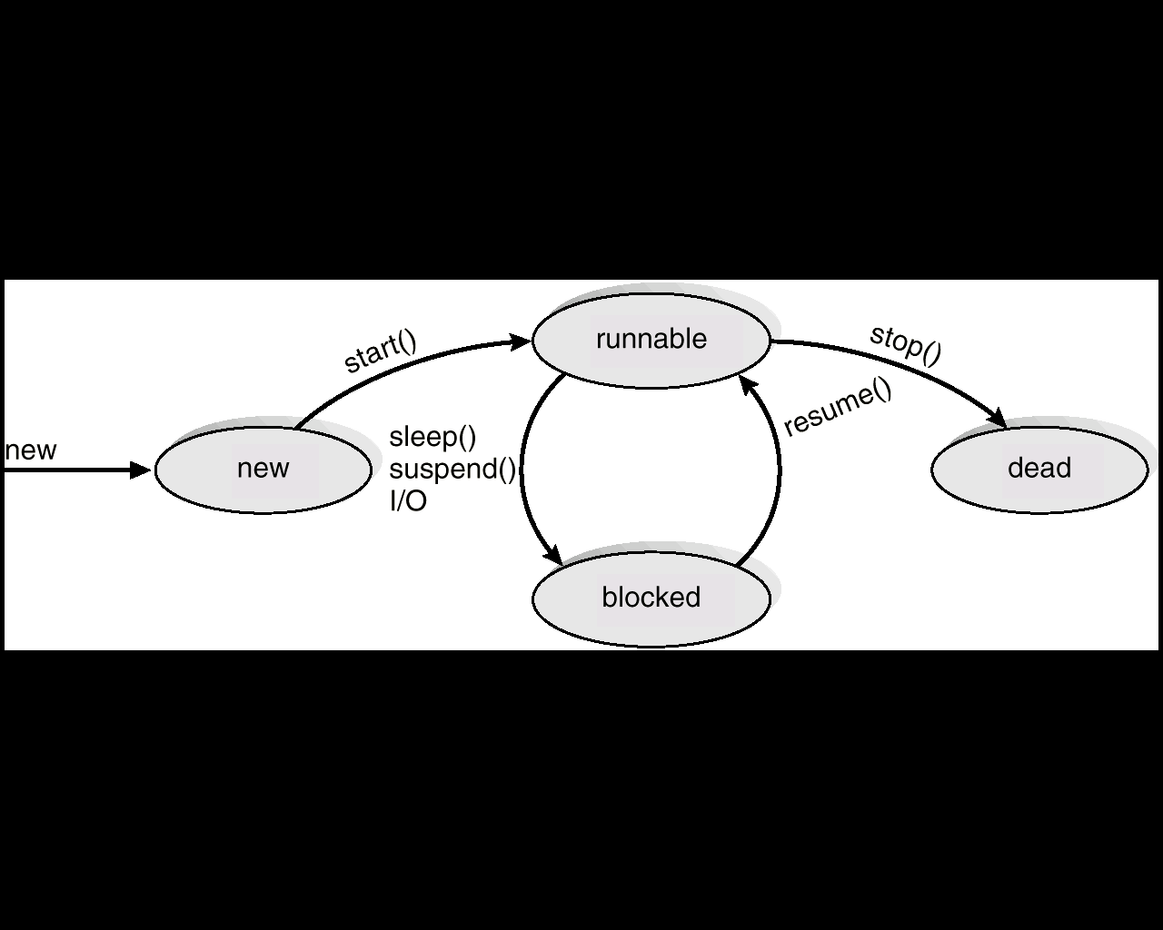
Java Thread States

Slide 61
Text Books & References :
Abraham Silberchatz, Peter B. Galvin, Greg Gagne, Operating System Concepts, 9th edition, John Wiley.
Stallings, Operating Systems-Internal and Design Principles, 6th edition, Pearson education.
D.M.Dhamdhere, Operating systems- A Concept based Approach, 2ndedition, TMH.
Crowley, Operating System A Design Approach, 1st edition, TMH.
Andrew S Tanenbaum, Modern Operating Systems, 3rd edition, PHI.
Gary J. Nutt, Operating Systems: A Modern Perspective, 2nd Edition, Addison-Wesley.
http://nptel.iitm.ac.in/courses/Webcourse-contents/IISc-BANG/Operating%20Systems /New_index1.html

Slide 62
Operating Systems Unit II::Process Management CPU Scheduling

Slide 63
Outline
Basic Concepts
Scheduling Criteria
Scheduling Algorithms
Multiple-Processor Scheduling
Real-Time Scheduling
Algorithm Evaluation

Slide 64
1.Basic Concepts
Maximum CPU utilization obtained with multiprogramming
CPU–I/O Burst Cycle – Process execution consists of a cycle of CPU execution and I/O wait.
CPU burst distribution

Slide 65
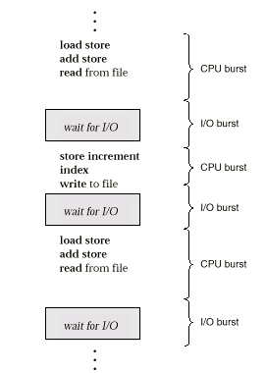
Alternating Sequence of CPU And I/O Bursts

Slide 66
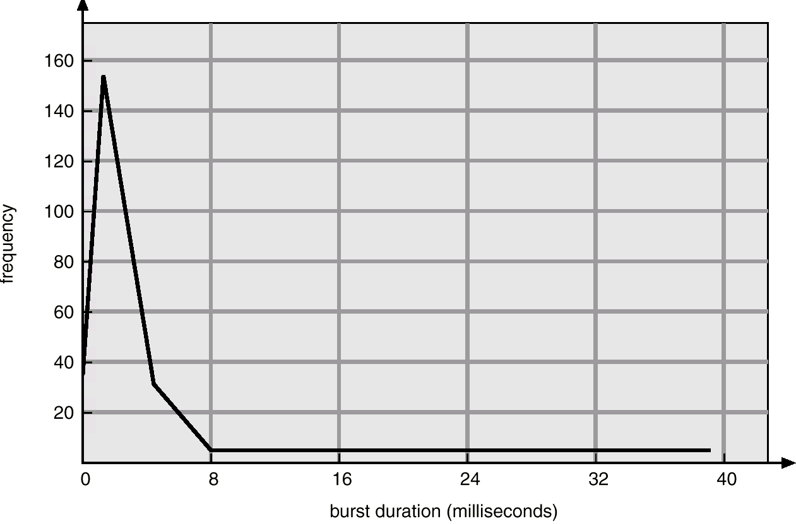
Histogram of CPU-burst Times

Slide 67
CPU Scheduler
Selects from among the processes in memory that are ready to execute, and allocates the CPU to one of them.
CPU scheduling decisions may take place when a process:
1. Switches from running to waiting state.
2. Switches from running to ready state.
3. Switches from waiting to ready.
4. Terminates.
Scheduling under 1 and 4 is nonpreemptive.
All other scheduling is preemptive.

Slide 68
Dispatcher
Dispatcher module gives control of the CPU to the process selected by the short-term scheduler; this involves:
switching context
switching to user mode
jumping to the proper location in the user program to restart that program
Dispatch latency – time it takes for the dispatcher to stop one process and start another running.

Slide 69
2.Scheduling Criteria
CPU utilization – keep the CPU as busy as possible
Throughput – # of processes that complete their execution per time unit
Turnaround time – amount of time to execute a particular process
Waiting time – amount of time a process has been waiting in the ready queue
Response time – amount of time it takes from when a request was submitted until the first response is produced, not output (for time-sharing environment)

Slide 70
Optimization Criteria
Max CPU utilization
Max throughput
Min turnaround time
Min waiting time
Min response time

Slide 71
First-Come, First-Served (FCFS) Scheduling
3.Scheduling Algorithms
Process Burst Time
P₁ 24
P₂ 3
P₃ 3
Suppose that the processes arrive in the order: P₁ , P₂ , P₃ The Gantt Chart for the schedule is:
Waiting time for P₁ = 0; P₂ = 24; P₃ = 27
Average waiting time: (0 + 24 + 27)/3 = 17
P₁
P₂
P₃
0
24
27
30

Slide 72
FCFS Scheduling (Cont.)
Suppose that the processes arrive in the order
P₂ , P₃ , P₁ .
The Gantt chart for the schedule is:
Waiting time for P₁ = 6; P₂ = 0; P₃ = 3
Average waiting time: (6 + 0 + 3)/3 = 3
Much better than previous case.
Convoy effect short process behind long process
P₂
P₃
P₁
0
3
6
30

Slide 73
Shortest-Job-First (SJR) Scheduling
Associate with each process the length of its next CPU burst. Use these lengths to schedule the process with the shortest time.
Two schemes:
nonpreemptive – once CPU given to the process it cannot be preempted until completes its CPU burst.
preemptive – if a new process arrives with CPU burst length less than remaining time of current executing process, preempt. This scheme is know as the Shortest-Remaining-Time-First (SRTF).
SJF is optimal – gives minimum average waiting time for a given set of processes.

Slide 74
Example of Non-Preemptive SJF
Process Arrival Time Burst Time
P₁ 0.0 7
P₂ 2.0 4
P₃ 4.0 1
P₄ 5.0 4
SJF (non-preemptive)
Average waiting time = (0 + 6 + 3 + 7)/4 - 4
P₁
P₃
P₂
P₄
0
3
7
8
12
16

Slide 75
Example of Preemptive SJF
Process Arrival Time Burst Time
P₁ 0.0 7
P₂ 2.0 4
P₃ 4.0 1
P₄ 5.0 4
SJF (preemptive)
Average waiting time = (9 + 1 + 0 +2)/4 - 3
P₁
P₂
P₃
P₂
P₄
P₁
0
2
4
5
7
11
16

Slide 76
Determining Length of Next CPU Burst
Can only estimate the length.
Can be done by using the length of previous CPU bursts, using exponential averaging.

Slide 77
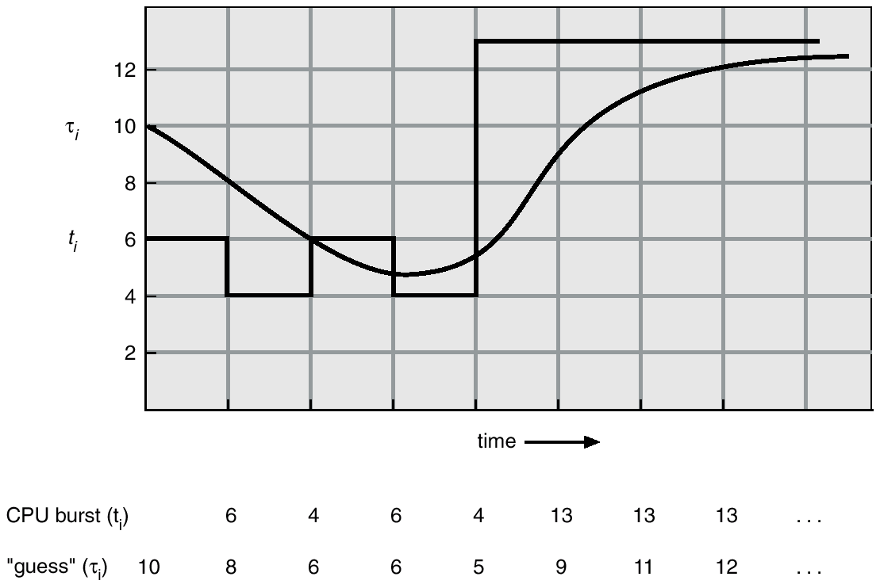
Prediction of the Length of the Next CPU Burst

Slide 78
Examples of Exponential Averaging
α =0
τ_{n+1} = τ_{n}
Recent history does not count.
α =1
τ_{n+1} = t_{n}
Only the actual last CPU burst counts.
If we expand the formula, we get:
τ_{n+1} = α t_{n}+(1 - α) α t_{n} -1 + …
+(1 - α )^{j} α t_{n} -1 + …
+(1 - α )^{n=1} t_{n} τ₀
Since both α and (1 - α) are less than or equal to 1, each successive term has less weight than its predecessor.

Slide 79
Priority Scheduling
A priority number (integer) is associated with each process
The CPU is allocated to the process with the highest priority (smallest integer ≡ highest priority).
Preemptive
nonpreemptive
SJF is a priority scheduling where priority is the predicted next CPU burst time.
Problem ≡ Starvation – low priority processes may never execute.
Solution ≡ Aging – as time progresses increase the priority of the process.

Slide 80
Round Robin (RR)
Each process gets a small unit of CPU time (time quantum), usually 10-100 milliseconds. After this time has elapsed, the process is preempted and added to the end of the ready queue.
If there are n processes in the ready queue and the time quantum is q, then each process gets 1/n of the CPU time in chunks of at most q time units at once. No process waits more than (n-1)q time units.
Performance
q large ⇒ FIFO
q small ⇒ q must be large with respect to context switch, otherwise overhead is too high.

Slide 81
Example of RR with Time Quantum = 20
Process Burst Time
P₁ 53
P₂ 17
P₃ 68
P₄ 24
The Gantt chart is:
Typically, higher average turnaround than SJF, but better response.
P₁
P₂
P₃
P₄
P₁
P₃
P₄
P₁
P₃
P₃
0
20
37
57
77
97
117
121
134
154
162

Slide 82
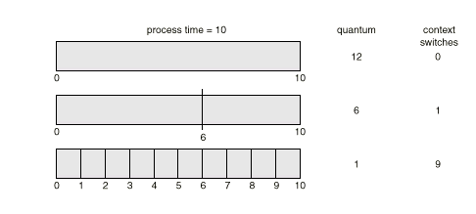
Time Quantum and Context Switch Time

Slide 83
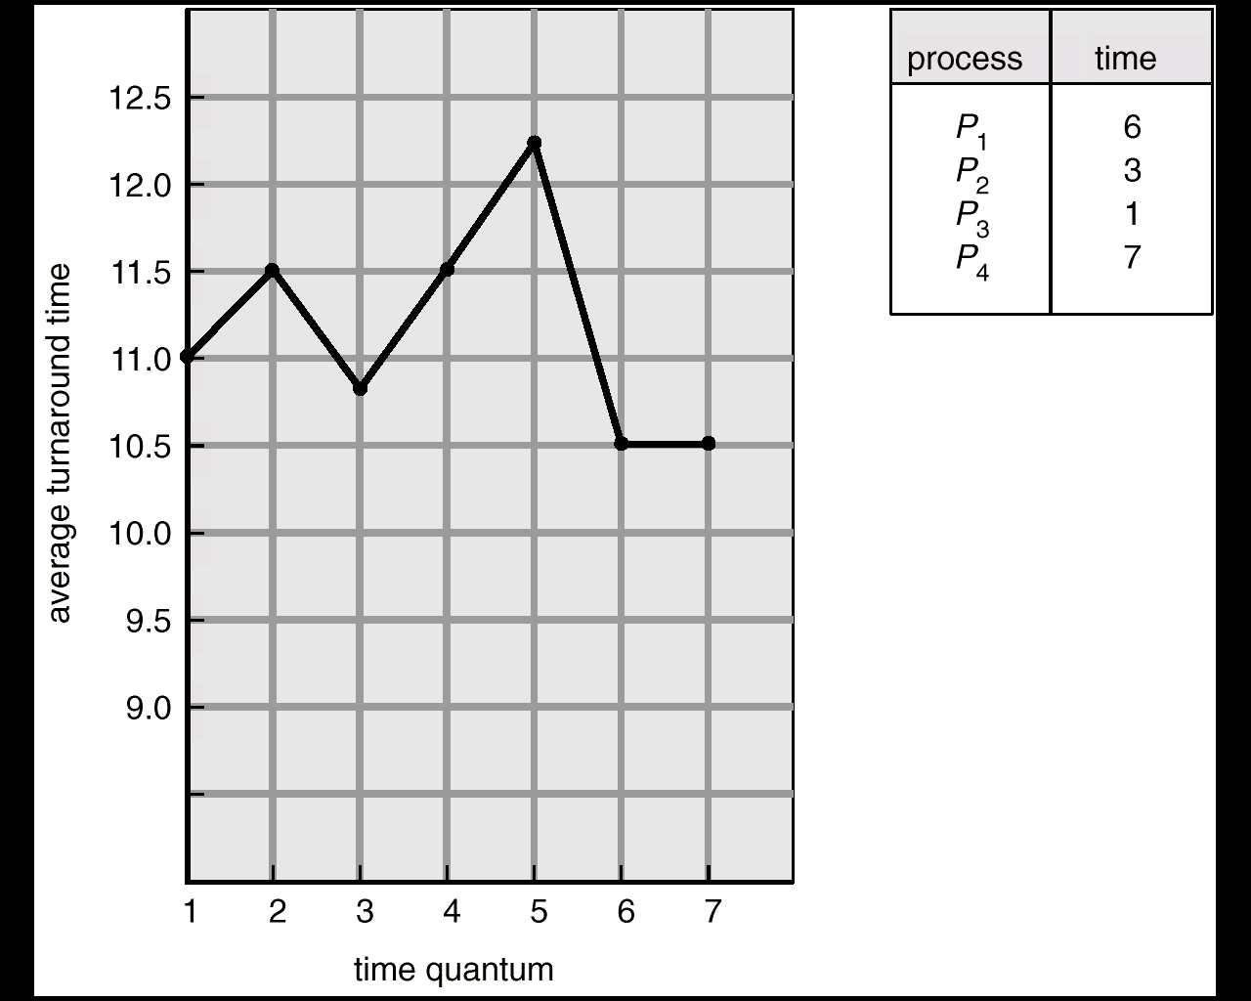
Turnaround Time Varies With The Time Quantum

Slide 84
Multilevel Queue
Ready queue is partitioned into separate queues: foreground (interactive) background (batch)
Each queue has its own scheduling algorithm, foreground – RR background – FCFS
Scheduling must be done between the queues.
Fixed priority scheduling; (i.e., serve all from foreground then from background). Possibility of starvation.
Time slice – each queue gets a certain amount of CPU time which it can schedule amongst its processes; i.e., 80% to foreground in RR
20% to background in FCFS

Slide 85
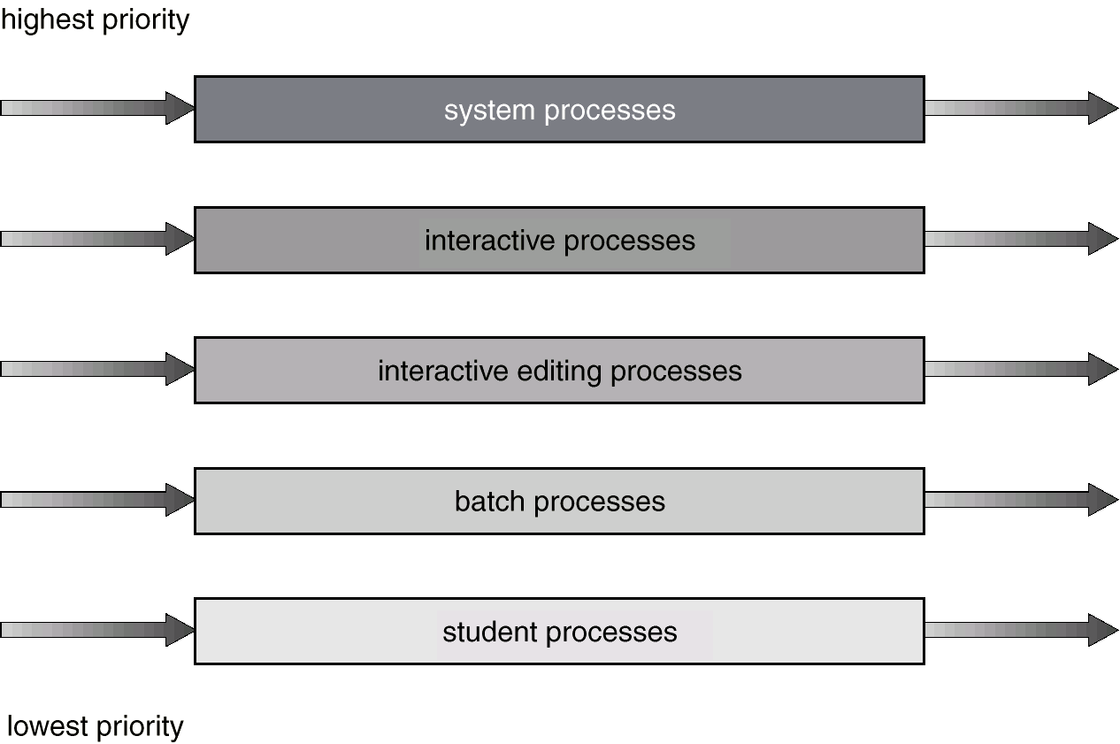
Multilevel Queue Scheduling

Slide 86
Multilevel Feedback Queue
A process can move between the various queues; aging can be implemented this way.
Multilevel-feedback-queue scheduler defined by the following parameters:
number of queues
scheduling algorithms for each queue
method used to determine when to upgrade a process
method used to determine when to demote a process
method used to determine which queue a process will enter when that process needs service

Slide 87
Example of Multilevel Feedback Queue
Three queues:
Q₀ – time quantum 8 milliseconds
Q₁ – time quantum 16 milliseconds
Q₂ – FCFS
Scheduling
A new job enters queue Q₀ which is served FCFS. When it gains CPU, job receives 8 milliseconds. If it does not finish in 8 milliseconds, job is moved to queue Q₁.
At Q₁ job is again served FCFS and receives 16 additional milliseconds. If it still does not complete, it is preempted and moved to queue Q₂.

Slide 88
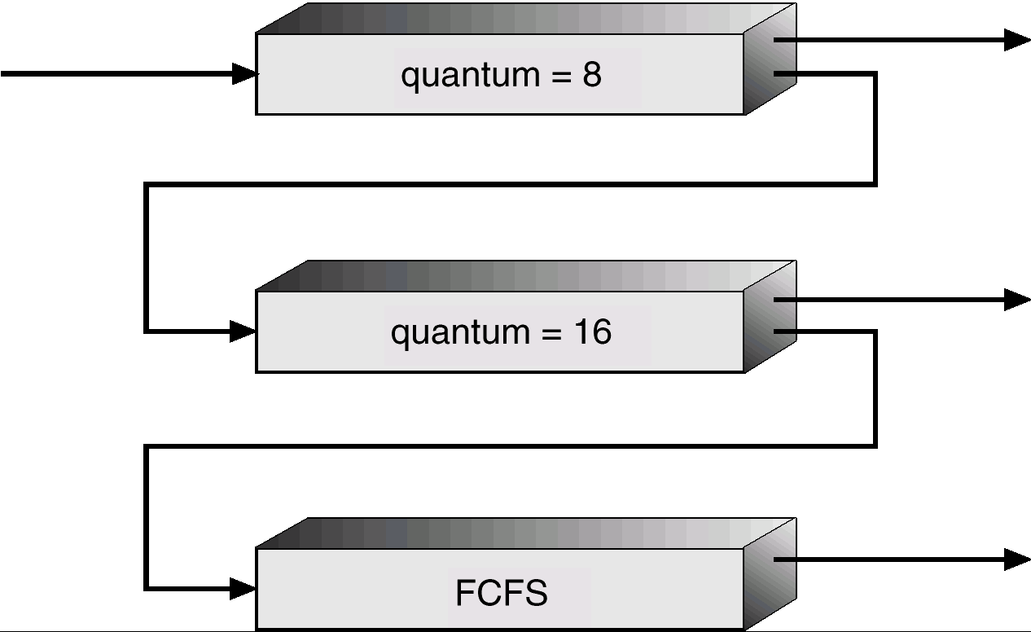
Multilevel Feedback Queues

Slide 89
4.Multiple-Processor Scheduling
CPU scheduling more complex when multiple CPUs are available.
Homogeneous processors within a multiprocessor.
Load sharing
Asymmetric multiprocessing – only one processor accesses the system data structures, alleviating the need for data sharing.

Slide 90
5.Real-Time Scheduling
Hard real-time systems – required to complete a critical task within a guaranteed amount of time.
Soft real-time computing – requires that critical processes receive priority over less fortunate ones.

Slide 91
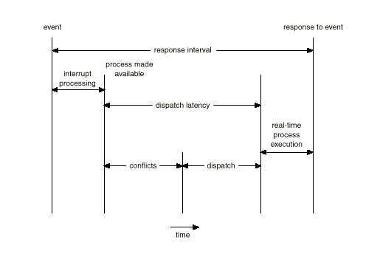
Dispatch Latency

Slide 92
6.Algorithm Evaluation
Deterministic modeling – takes a particular predetermined workload and defines the performance of each algorithm for that workload.
Queueing models
Implementation

Slide 93
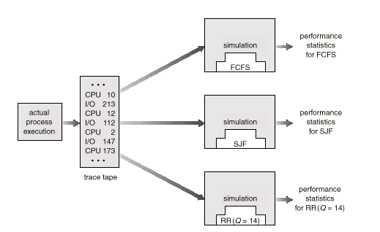
Evaluation of CPU Schedulers by Simulation

Slide 94
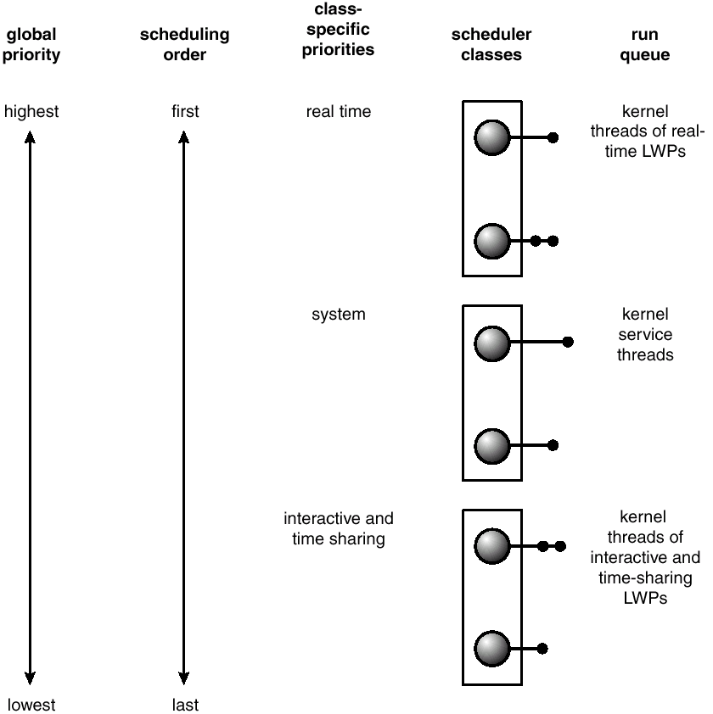
Solaris 2 Scheduling

Slide 95
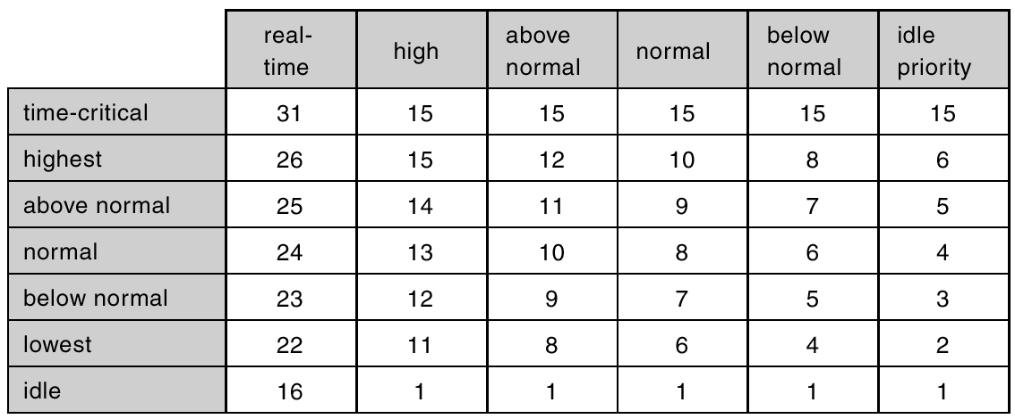
Windows 2000 Priorities

Slide 96
Text Books & References :
Abraham Silberchatz, Peter B. Galvin, Greg Gagne, Operating System Concepts, 9th edition, John Wiley.
Stallings, Operating Systems-Internal and Design Principles, 6th edition, Pearson education.
D.M.Dhamdhere, Operating systems- A Concept based Approach, 2ndedition, TMH.
Crowley, Operating System A Design Approach, 1st edition, TMH.
Andrew S Tanenbaum, Modern Operating Systems, 3rd edition, PHI.
Gary J. Nutt, Operating Systems: A Modern Perspective, 2nd Edition, Addison-Wesley.
http://nptel.iitm.ac.in/courses/Webcourse-contents/IISc-BANG/Operating%20Systems/New_index1.html

Slide 97
Thank You

